Slide 1
Solving Op Amp Stability Issues Part 4
(For Voltage Feedback Op Amps)
Tim Green & Collin Wells
Precision Analog Linear Applications
<number>
Notes:
This presentation will focus on techniques to solve voltage feedback op amp stability problems. The content is intended to teach any range of professional, from technician to PHD, to become an op amp stability expert!
<number>

Slide 2
Appendix Index
<number>

Slide 3
8) CF Inverting (Input Cload)
<number>

Slide 4
Aol and 1/β
<number>
Notes:
<number>
We can use our SPICE Loop Gain Test circuit above to plot Aol and 1/β for this Gain = -1 circuit. Note that the 1/β curve has a zero in it at 104kHz. At fcl, where Loop Gain (Aolβ) goes to zero, we see that the 1/β curve intersects the Aol at a rate-of-closure that is 40dB/decade which by our criteria implies an UNSTABLE circuit.

Slide 5
Op Amp Input Capacitance
<number>
Notes:
To properly analyze this circuit and thus properly compensate it for stability we first must analyze the OPA140 op amp input capacitance. The datasheet excerpt for the OPA140 is shown here with Input Impedance parameters for Differential and Common-Mode. The input capacitance model for the OPA140 is also shown. From the data sheet we can assign values for the capacitances shown, Ccm+, Ccm-, and Cdiff.

Slide 6
Equivalent Input Capacitance and β
<number>
Notes:
<number>
From our input capacitance model for the OPA140 and the circuit topology it is configured in we see there is a net input capacitance, Cin_eq which will affect our feedback factor, β, over frequency. Since the Cin_eq capacitor is buffered by RF, 180k ohm resistor, there are no loading effects on Aol with this circuit topology and so the Aol remains unchanged.

Slide 7
Equivalent Input Capacitance and 1/β
(Set to 1V)
β
<number>
Notes:
<number>
Our β network is shown above. β is easy to compute if one sets VOUT = 1. β=(input impedance)/(feedback impedance + input impedance). Recall that 1/β is just the reciprocal of β. From our derived and simplified equations above we see a zero, fz1, in the 1/β plot due to RF, RI and Cin_eq. Note that although our closed loop gain is -1 our 1/β is at 6dB or x2. Remember our earlier discussion of noise gain and to view the op amp, from a loop gain view, to always be running in a noise gain equivalent to putting a noise source on the +input of the op amp and running in the non-inverting gain based on feedback and input impedances from output to –input.

Slide 8
CF Compensation Design Steps
Determine fz1 in 1/β due to Cin_eq
Measure in SPICE
OR
B) Compute by Datasheet C_{DIFF}and C_{CM} and Circuit RF and RI
Plot 1/β with fz1 on original Aol
3) Add Desired fp1 on 1/β for CF Compensation
Keep fp1 < 10*fz1
Keep fp1 < 1/10 * fcl
4) Compute value for CF based on plotted fp1
5) SPICE simulation with CF for Loop Gain (Aolβ) Magnitude and Phase
Adjust CF Compensation if greater Loop Gain (Aolβ) phase margin desired
7) Check closed loop AC response for VOUT/VIN
Look for peaking which indicates marginal stability
Check if closed AC response is acceptable for end application
8) Check Transient response for VOUT/VIN
A) Overshoot and ringing in the time domain indicates marginal stability
<number>
Notes:
<number>
The CF Compensation design steps are outlined here. Rules-of-thumb are presented to yield best stability on first pass analysis.

Slide 9
1),2),3) Plot Aol, 1/β, Add fp1 in 1/β for Stability
For fp1:
fp1 < 10 * fz1
fp1 < 1/10 * fcl
<number>
Notes:
<number>
Using our Loop Gain Test circuit in SPICE we can plot the Aol and 1/β for the uncompensated circuit as shown above. For best stability results on first pass we use the recommended rules-of-thumb shown and draw in what we want the final 1/β curve to look like. Based on this graphical approach we see we need a pole, fp1, added into the 1/β curve to allow the compensated 1/β to intersect the Aol at a rate-of-closure which is 20db/decade and thus stable by our criteria.
From above we have completed Steps 1, 2, and 3 for the CF Compensation Design:
Determine fz1 in 1/β due to Cin_eq
Measure in SPICE
Compute by Datasheet C_{DIFF} and C_{CM} and Circuit RF and RI
Plot 1/β with fz1 on original Aol
3) Add Desired fp1 on 1/β for CF Compensation
Keep fp1 < 10*fz1
Keep fp1 < 1/10 * fcl

Slide 10
4) Compute value of CF
<number>
Notes:
<number>
Our β network is shown above. β is easy to compute if one sets VOUT = 1. β=(input impedance)/(feedback impedance + input impedance). Recall that 1/β is just the reciprocal of β. From our derived and simplified equations above we see a zero, fz1, in the 1/β plot due to RF, RI, Cin_eq, and CF. Note that although our closed loop gain is -1 our 1/β is at 6dB or x2. Remember our earlier discussion of noise gain and to view the op amp, from a loop gain view, to always be running in a noise gain equivalent to putting a noise source on the +input of the op amp and running in the non-inverting gain based on feedback and input impedances from output to –input. Note that with the addition of CF Compensation the 1/β zero, fz1, is moved to a lower frequency since CF is in parallel with Cin_eq to determine the location of fz1. However, to choose the CF Compensation pole, fp1, it is only dependent upon Rf and CF.
From above we have completed Step 4 for the CF Compensation Design:
4) Compute value for CF based on plotted fp1

Slide 11
5), 6) Loop Gain Check
Phase Margin at fcl = 68 degrees
<number>
Notes:
<number>
Design Step 5 for CF Compensation is to check the final CF value chosen by a loop gain plot on the complete op amp circuit. We see from above that at fcl, where Loop Gain (Aolβ) goes to zero, the phase margin is 68 degrees. Step 6 is to adjust CF for more phase margin if we are not satisfied with our first analysis and re-run the loop gain and phase plot to check the final design. Here we are happy with 68 degrees of Loop Gain (Aolβ) phase margin.
From above we have completed Steps 5 & 6 for the CF Compensation Design:
SPICE simulation with CF for Loop Gain (Aolβ) Magnitude and Phase
Adjust CF Compensation if greater Loop Gain (Aolβ) phase margin desired
.

Slide 12
7) VOUT/VIN AC Response
<number>
Notes:
<number>
Design Step 7 for CF Compensation is to check the closed loop AC response over frequency. From above, see the closed loop AC response for both the output of the op amp, VOUT. If this closed loop bandwidth is not acceptable for the final application we will need to consider other capacitive stability techniques (see Appendix) or a different op amp or different feedback and input resistor values of lower values.
From above we have completed Step 7 for the CF Compensation Design:
Check closed loop AC response for VOUT/VIN
Look for peaking which indicates marginal stability
Check if closed AC response is acceptable for end application

Slide 13
8) Transient Analysis
<number>
Notes:
<number>
Design Step 8 for CF Compensation is to check the closed loop transient response. From above we see the closed loop Transient response for VOUT shows no signs of excessive overshoot or ringing before settling.
From above we have completed Step 7 for the CF Compensation Design:
Check Transient response for VOUT/VIN
A) Overshoot and ringing in the time domain indicates marginal stability

Slide 14
9) Noise Gain Inverting and Noise Gain Non-Inverting (Output Cload)
<number>

Slide 15
Original Circuit: Transient Response
<number>

Slide 16
Noise-Gain Compensation Circuit Configurations
Non-Inverting:
Inverting:

Slide 17
Noise-Gain Circuit Equations
1/β Transfer Function:
DC 1/β Magnitude:
Hi-Freq 1/β Magnitude:
=> Solve for RN
1/Beta Pole Frequency:
=> Solve for CN
The op amp equivalent input capacitance, CI, has been left out of these equations to simplify them. If CI and RF||RI are causing a stability issue (Appendix 7), consider a different approach
1/Beta Zero Frequency:
<number>

Slide 18
Noise-Gain Compensation Design Steps
Break the loop and plot Aol and 1/ β
Determine fp2 in Loaded Aol due to Cload
Determine Aol Magnitude at fp2, Aol(fp2)
Select RN so 1/β_Hi-f > Aol(fp2) +3dB 1/β_Hi-f: the High-Frequency 1/β magnitude
Plot 1/β_Hi-f and determine new fcl
Select value for CN based on required fp3 frequency
Keep fp3 < fcl/10
To prevent AolB phase dip, Keep fp3 < 10*fz1
SPICE simulation with Riso for Loop Gain (Aolβ) Magnitude and Phase
Adjust CN if greater Loop Gain (Aolβ) phase margin desired
Check closed loop AC response for VOUT/VIN
Look for peaking which indicates marginal stability
Check if closed AC response is acceptable for end application
7) Check Transient response for VOUT/VIN
A) Overshoot and ringing in the time domain indicates marginal stability
<number>
Notes:
<number>
The Riso Compensation design steps are outlined here. Two cases, Case A and Case B, will be presented. Rules-of-thumb will be presented to yield best stability on first pass analysis.

Slide 19
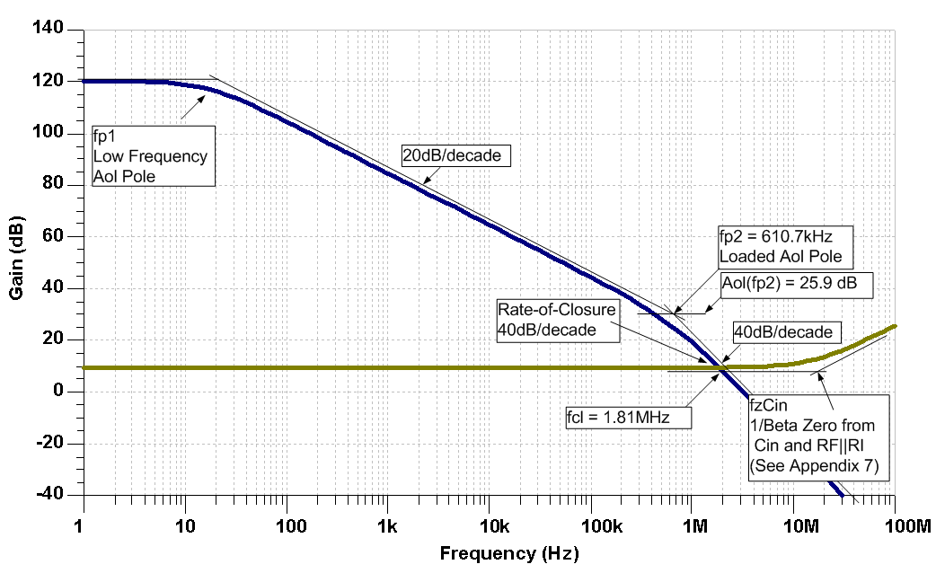
1) Original Circuit: Break the Loop
<number>

Slide 20
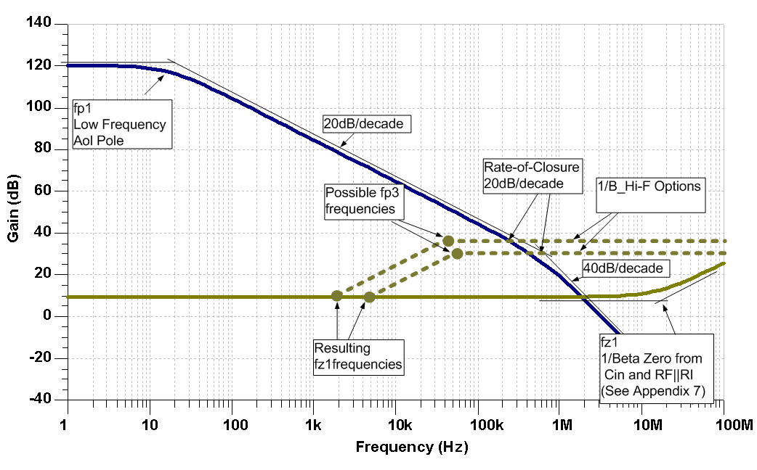
1) Desired Compensation for Original Circuit
<number>

Slide 21
2) Calculate RN
From Step 1:
For stability keep 1/β_Hi-F > Aol(fp2) +3dB:
Convert 1/β_Hi-F to V/V:
Calculate RN(max):

Slide 22
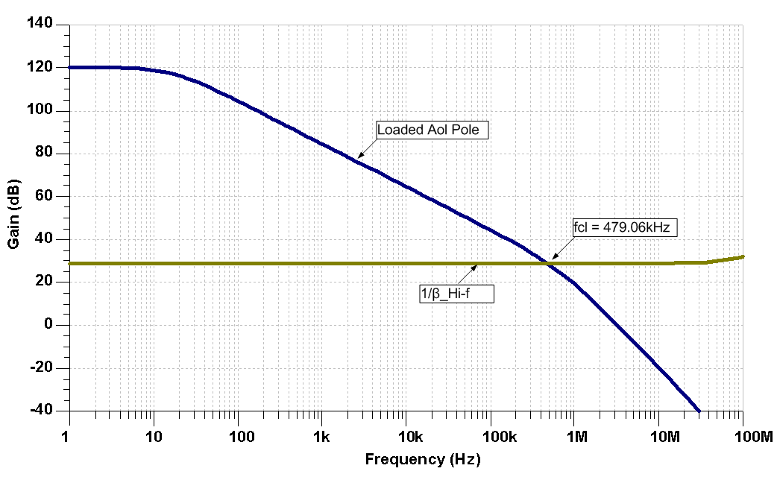
2A) Find fcl with 1/β_Hi-f
<number>

Slide 23
3) Select CN
From Steps 1 and 4:
For stability keep fp3 ≤ fcl/10:

Slide 24
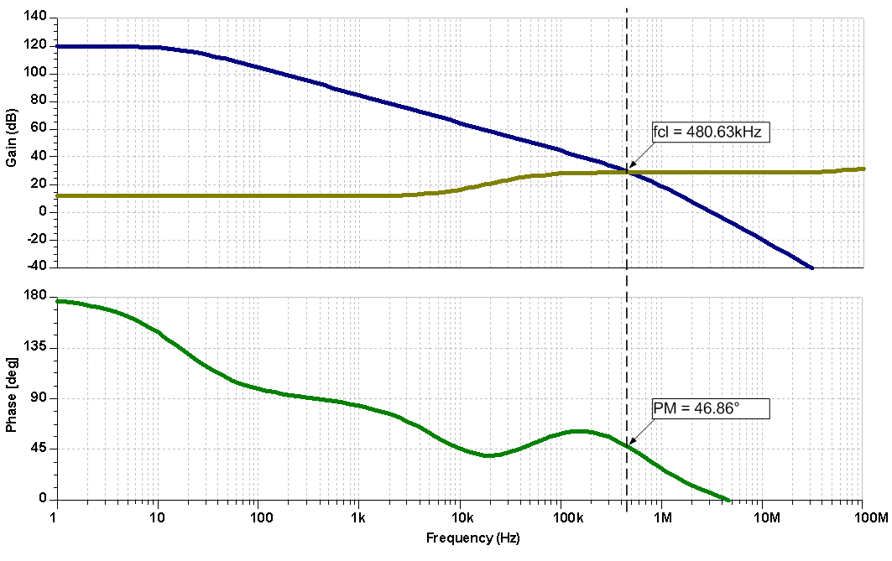
4),5) Plot Aol and 1/Beta for Compensated Circuit
<number>

Slide 25
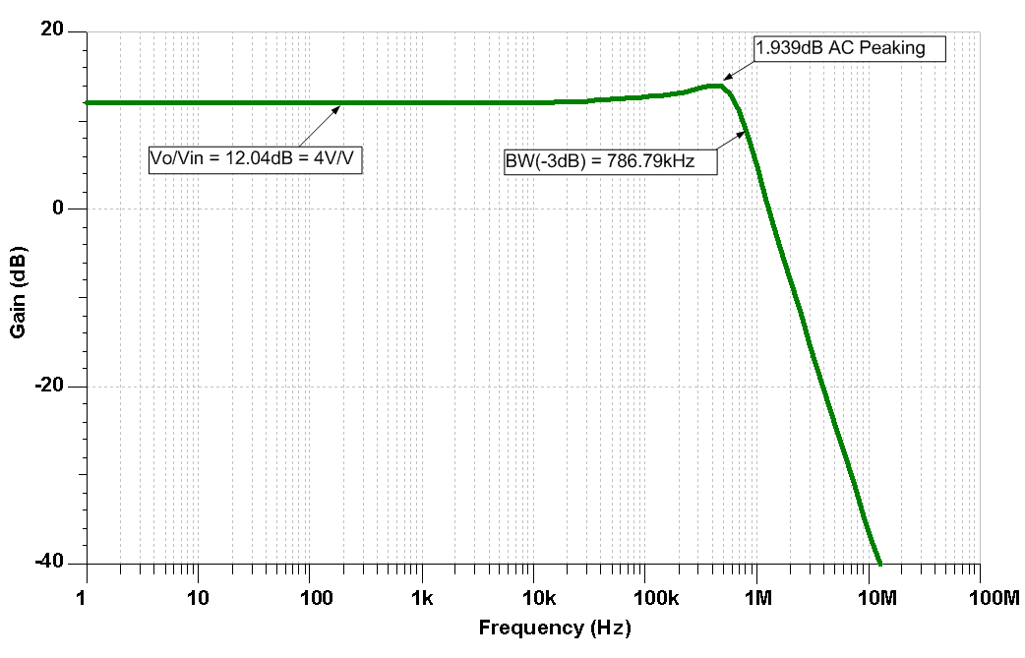
6) Plot Compensated Closed-Loop Gain
<number>

Slide 26
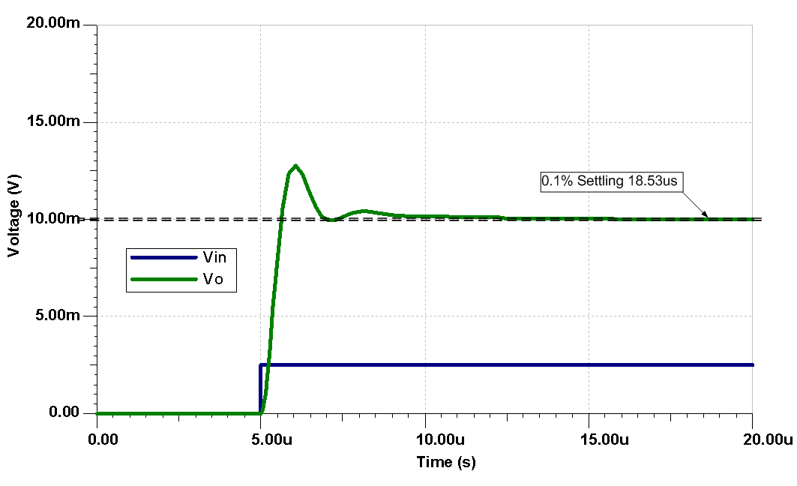
7) Plot Compensated Transient Response
<number>

Slide 27
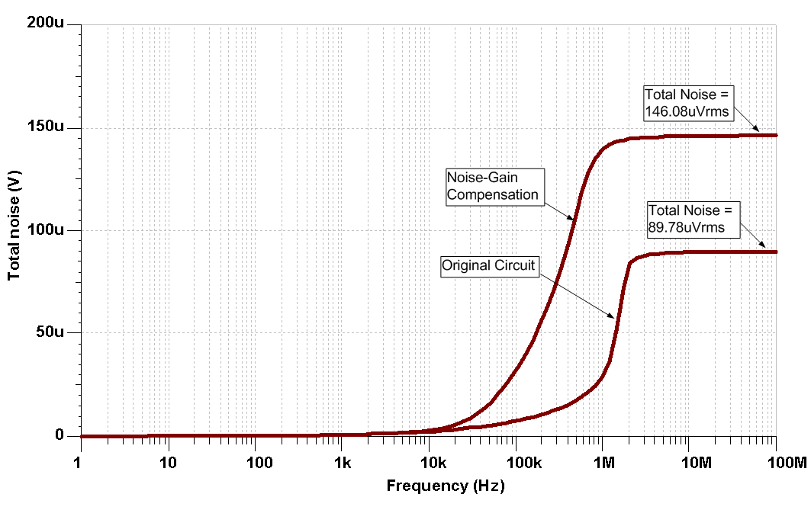
It’s called “Noise-Gain” for a reason
<number>

Slide 28
Watch Out for Source Impedance
Note for Non-Inverting Noise Gain Compensation:
Keep Rsource (RS) < 1/10*RN
OR
2) Add capacitor at U1, +input, to ground to lower impedance to < 1/10*RN at fp3 for effective Non-Inverting Noise Gain Compensation
<number>

Slide 29
Noise-Gain Compensation Summary
Set 1/ β_Hi-f ≥ Aol(fp2)
Determine the new fcl
Set CN so fp3 ≤ fcl/10
Avoid using this circuit in instances where fp3 ≥ fz1*10 or large Loop Gain (Aolβ) phase dipping will occur which minimizes phase buffer for frequencies < fcl
<number>

Slide 30
10) Noise Gain and CF (Output Cload)
<number>

Slide 31
Noise Gain and CF: Programmable Power Supply (PPS) Design Example
Define min and max load condition
Design for:
250nA< Iout <2A
Cload = 10μF
Check for stability at Iout range
DC and Transient Analysis Circuit
<number>

Slide 32
Original Transient Analysis
<number>

Slide 33
Noise Gain and CF Compensation Design Steps
Define min and max load condition
SPICE simulation for Loaded Aol curves (min and max load)
Plot Desired 1/β on Loaded Aol curves (min and max load)
A) Use Noise Gain and CF Compensation
4) From Desired 1/β detemine fp3, fp4, and Mid-Band Gain
5) Compute values for RF, CF, Rn, Cn based on plotted fp3, fp4, Mid-Band Gain
6) SPICE simulation w/final compensation for Loop Gain (Aolβ) Magnitude and Phase
7) Adjust Compensation if greater Loop Gain (Aolβ) phase margin desired
8) Check closed loop AC response for VOUT/VIN
Look for peaking which indicates marginal stability
Check if closed AC response is acceptable for end application
9) Check Transient response for VOUT/VIN
A) Overshoot and ringing in the time domain indicates marginal stability
<number>
Notes:
<number>
The CF Compensation design steps are outlined here. Rules-of-thumb will be present to yield best stability on first pass analysis.

Slide 34
2) Loop Gain Check for Loaded Aol
<number>

Slide 35
2),3),4) Loaded Aol and Desired 1/β
On Loaded Aol Curves add Desired 1/β:
Noise Gain & CF Compensation
fp3=336Hz
fp4=10.6kHz
Mid-Band Gain = 30dB
<number>
Notes:
1) Loaded Aol_A Curve:
fp1_A is low frequency pole from op amp unloaded Aol down around 1Hz. fp2_A is second pole in Loaded Aol_A due to Zo and CLoad.
2) Loaded Aol_B Curve:
fp1_B is low frequency pole in Loaded Aol due to lower resistive loading of 1.25 ohms on CMOS output. fp2_B is second pole in Loaded Aol_A due to Zo and CLoad.
3) Desired 1/β Curve:
fz1 and fp3 are a zero and pole due t noise gain set by Rn and Cn. We do not need to know exact location of fz1 since once we set fp3, fz1 can be seen graphically by using a +20dB/decade slope from fp3 down in frequency to the DC gain of 0dB. Noise gain fp3 is easy to find and compute.
fp4 is due to CF.
fz1 is the result of high frequency 1/β going to 0dB due to CF acting as a short at high frequencies.
All we need from our drawn, Desired 1/β curve is fp3, Mid-Band Gain and fp4. The other 1/β zeroes will occur as plotted by the nature of the input and feedback networks containing only one reactive element.
General considerations:
Because of the large difference between the two loaded Aol curves at high frequency it is necessary to plot the Desired 1/β as the best compromise to keep most phase margin for the two cases. This is shown here. We will strive for better than 45 degrees phase margin for each case to allow for Aol shifts in the real world. A worst case Aol frequency shift at the Unity Gain Bandwidth (UGBW), over process and temperature, can be estimated as ½*UGBW to 1.5*UGBW. For best “Phase Buffer” we prefer to keep fp3 and fz1 one decade apart. We cannot quite do that here so we compromise as shown.
<number>

Slide 36
5) Noise Gain and CF Compensation
Noise Gain & CF Compensation
fp3=336Hz
fp4=10.6kHz
Mid-Band Gain = 30dB
Loop Gain (Aolβ), Loaded Aol, 1/ β Circuit
<number>

Slide 37
5) Final Compensation: 1/β & Loaded Aol
<number>

Slide 38
6) Final Compensation: Loop Gain (Aolβ)
Phase Margin
Phase Margin
<number>
Notes:
<number>

Slide 39
7) Final Compensation: Vout/Vin AC Closed Loop
Note for Non-Inverting Noise Gain Compensation:
Rsource < 1/10*Rn
OR
2) Add capacitor (>10*Cn) at U1, +input, to ground to lower impedance to < 1/10*Rn at fp3 for effective Non-Inverting Noise Gain Compensation
Vout/Vin AC Closed Loop and Transient Circuit
<number>

Slide 40
8) Final Compensation: Vout/Vin AC Closed Loop
<number>

Slide 41
9) Final Compensation: Transient Analysis
<number>

Slide 42
11) Output Pin Compensation (Output Cload)
<number>

Slide 43
Output Pin Compensation – Design Example
<number>

Slide 44
INA152 Transient Analysis – No Compensation
<number>

Slide 45
Aol Test Circuit for Difference Amp
<number>

Slide 46
INA152 Aol
<number>

Slide 47
INA152 Aol
<number>

Slide 48
Output Pin Compensation Design Steps
SPICE simulation for Loaded Aol curves (min and max load)
Measure Zo in SPICE
3) Determine if CLoad is on resistive portion of Zo
4) Plot Loaded Aol Original and Loaded Aol New for Ouptut Pin Compensation
5) Compute Rco and Cco and check Loaded Aol New in SPICE
6) SPICE simulation w/final compensation for Loop Gain (Aolβ) Magnitude and Phase
7) Adjust Compensation if greater Loop Gain (Aolβ) phase margin desired
8) Check closed loop AC response for VOUT/VIN
Look for peaking which indicates marginal stability
Check if closed AC response is acceptable for end application
9) Check Transient response for VOUT/VIN
A) Overshoot and ringing in the time domain indicates marginal stability
<number>
Notes:
<number>
The CF Compensation design steps are outlined here. Rules-of-thumb will be present to yield best stability on first pass analysis.

Slide 49
1) INA152 Loaded Aol
<number>

Slide 50
1) INA152 Loaded Aol
<number>

Slide 51
2) INA152 Z_{O} Test
<number>

Slide 52
2) TINA SPICE Z_{O} Test Circuit
<number>

Slide 53
2) INA152 Z_{O} Magnitude
<number>

Slide 54
2) INA152 Z_{O} Pole and Zero
<number>

Slide 55
3) INA152 Z_{O} and CL
Note :
For both capacitive values of CL
the load impedance interacts with
Zo in its “high frequency” Zo resistive
region (Zo_Hif).
<number>

Slide 56
4) INA152 Loaded Aol: Original and New
Add Cco = 10x CL then fp3 will move one decade to the left of fp2
Add Rco to create fz1
Keep fz1 < 10*fp3 for overall best loop gain phase margin
<number>

Slide 57
5) Compute Rco and Cco
Not seen by
Output Pin Compensation
Loaded Aol New
<number>

Slide 58
5) Compute Rco and Cco and check in SPICE
<number>

Slide 59
5) Compute Rco and Cco and check in SPICE
<number>

Slide 60
6),7) Loop Gain Check
<number>

Slide 61
6),7) Loop Gain Check
Loop Gain
Phase Margin = 47 degrees
<number>

Slide 62
8) Closed Loop AC Response
<number>

Slide 63
8) Closed Loop AC Response
<number>

Slide 64
9) Transient Analysis
<number>

Slide 65
9) Transient Analysis
<number>

Slide 66
9) Transient Analysis
Zoom on VOUT
Rising Edge
Zoom on VOUT
Falling Edge
<number>

Slide 67
12) Riso with Dual Feedback (Output Cload) - Zo, 1/β, Aol Technique
<number>

Slide 68
Riso with Dual Feedback- Zo, 1/β, Aol Technique
1) Given: Op Amp and Cload
2) Determine Op Amp Zo
Measure in SPICE OR Data Sheet Curve
3) Create External Zo Model for Loop Gain Analysis only
4) If large RF value to be used model Cin_eq
4) Set Riso = 1/10*Ro → 1/β_Hif ≈ 20dB
5) SPICE simulation: Aol, 1/β FB#1
A) FB#1 gives: 1/β_Lof and fz1
6) Draw 1/β FB#2 (1/β_Hif ≈ 20dB from Step 4)
A) fp1=10*fz1
B) fz3=1/10*fp1
C) fp1<1/10*fcl
7) Choose RF and CF so standard values yield fz3
8) SPICE simulation: Loop Gain (Aolβ) Magnitude & Phase
A) Adjust compensation for more Loop Gain (Aolβ) phase margin if needed
9) Check closed loop AC response for VOUT/VIN
A) Look for peaking which indicates marginal stability
B) Check if closed AC response is acceptable for end application
10) Check Transient response for VOUT/VIN
A) Overshoot and ringing in the time domain indicates marginal stability
<number>
Notes:
<number>
The Riso Compensation design steps are outlined here. Two cases, Case A and Case B, will be presented. Rules-of-thumb will be presented to yield best stability on first pass analysis.

Slide 69
1) Riso w/Dual Feedback
Dual Feedback:
FB#1 through RF forces accurate Vout across CL
FB#2 through CF dominates at high frequency for stability
Riso provides isolation between FB#1 and FB#2
<number>

Slide 70
2) OPA177 Zo – SPICE Measurement
<number>
Notes:
For many op amp application circuits is will be necessary to know the op amp Open Loop Small Signal AC Output Impedance, Zo. Often this can be obtained from the op amp data sheet. Many op amp SPICE macromodels properly model Zo. If the data sheet contains a Zo curve we can easily check the macromodel for Zo accuracy. The test circuit here uses inductor, LT, in the feedback path to act as a short for the DC Operating Point analysis. The capacitor, CT, on the –input to ground is open for DC Analysis and will be a short for all frequencies of interest during the AC Analysis. Current Generator, IG1, is set to DC Current =0 and selected as AC Current of 1. During the AC Analysis IG1 injects current into the output, Vout, and the op amp is open loop. AC Analysis reports Vout in dB over frequency as a ratio of Vout/IG1 which is Zo, in dB. To convert Zo in dB to Zo in ohms simply change the y-axis scaling from dB-Linear to logarithmic.

Slide 71
3) Riso w/Dual Feedback – Zo External Model
Zo External Model:
VCVS1 ideally isolates U1 so U1 only provides data sheet Aol at VOA
Set Ro to match measured Ro
Analyze with unloaded Ro (largest Ro) which creates worst instability
Use 1/β on Aol stability analysis
1/ β, taken from VOA, will include the effects of Zo, Riso, and CL
<number>

Slide 72
3) Zo External Model, FB#1 and FB#2 Analysis
FB#1 and FB#2 1/ β Analysis:
There is only one net voltage fed back as β to the –input of the op amp
β_net = β_FB#1 + β_FB#2
This implies that the largest β will dominate → smallest 1/ β will dominate
Analyze FB#1 with CF = open since it will only dominate at high frequencies
Analyze FB#2 with CL = short since it is at least 10x CF
<number>

Slide 73
4) OPA177 Input Capacitance
****************************
* OPA177 "E" - ENHANCEMENTS
****************************
* OUTPUT SUPPLY MIRROR
FQ3 0 20 POLY(1) VLIM 0 1
DQ1 20 21 DX
DQ2 22 20 DX
VQ1 21 0 0
VQ2 22 0 0
FQ1 3 0 POLY(1) VQ1 0.976E-3 1
FQ2 0 4 POLY(1) VQ2 0.976E-3 -1
* QUIESCIENT CURRENT
RQ 3 4 3.0E4
* DIFF INPUT CAPACITANCE
CDIF 1 2 1.0E-12
* COMMON MODE INPUT CAPACITANCE
C1CM 1 99 1.5E-12
C2CM 2 99 1.5E-12
OPA177 Input Capacitance:
Ccm- and Ccm+ are common mode input capacitance
Cdiff is differential input capacitance
Ccm and Cdiff can usually be found in op amp data sheet
For OPA177 Ccm and Cdiff are found inside the SPICE macromodel
<number>

Slide 74
4) Cin_eq → Equivalent Input Capacitance for Loop Gain Analysis
Input Capacitance and Loop Gain Analysis:
Final Loop Gain circuit break needs to break both FB#1 and FB#2
Loop Gain circuit break will need to be made on op amp –input
For some op amps feedback elements can interact with input capacitance and add
zero or pole to 1/β
For Loop Gain analysis break loop at –input but add Cin_eq
<number>

Slide 75
5) 1/β FB#1 Analysis
Set Riso = 1/10*Ro → 1/β_Hif ≈ 20dB
<number>

Slide 76
5) 1/β FB#1 SPICE Results
C
TINA
SPICE
Post Processing
Math Anomaly
<number>

Slide 77
6) Add FB#2: Draw Desired 1/β FB#2on Aol & 1/β FB#1 Curves
<number>
Set Riso = 1/10*Ro → 1/β_Hif ≈ 20dB

Slide 78
7) 1/β FB#2 Analysis
For 1/β FB#2 SPICE Analysis:
Set Vref = 0V
Else OPA177 VOA will saturate with Vout = 5V into a short
Set Riso = 1/10*Ro → 1/β_Hif ≈ 20dB
<number>

Slide 79
7) 1/β FB#2 SPICE Results
<number>

Slide 80
7) SPICE 1/β Complete
<number>

Slide 81
8) SPICE Loop Gain Complete
Loop Gain
Phase Margin = 82 degrees
<number>

Slide 82
9) SPICE AC Closed Loop
<number>

Slide 83
9) SPICE AC Closed Loop
<number>

Slide 84
10) SPICE Transient Analysis
<number>

Slide 85
13) Riso with Dual Feedback (Output Cload) - 1/β, Loaded Aol Technique
<number>

Slide 86
Riso with Dual FB Topology (OPA330 Example)
<number>

Slide 87
Zo Test
<number>

Slide 88
Zo Test
<number>

Slide 89
Modified Aol
<number>

Slide 90
Zo and CL
Modified Aol will have Complex Poles with sharp phase shifts anywhere CL
Crosses Zo in Zo “Inductive” region.
<number>

Slide 91
Modified Aol with CL
<number>

Slide 92
Modified Aol with CL
<number>

Slide 93
Zo, CL, Riso
CL
CL
CL
Riso=400ohms, CL=1uF
Series Combination -
Highest Z wins -
Intersects Zo as Resistive Impedance
CL
CL
Riso
Riso
Riso
Riso
Riso
Riso
<number>

Slide 94
Modified Aol with CL=1uF, Riso=400ohms
<number>

Slide 95
Modified Aol with CL=1uF, Riso=400ohms
Note:
Modified Aol looks like an Aol with a second pole around 1kHz and a zero at about 20kHz
No abrupt phase shifts and minimum phase is 29.488 degrees away from 180 degree total phase shift
Modified Aol UGBW=56.5kHz with phase margin at 72.33 degrees
<number>

Slide 96
FB#1 with CL=1uF, Riso=400ohms
<number>

Slide 97
FB#1 with CL=1uF, Riso=400ohms
FB#2
fz2
Net 1/Beta
Lowest FB Wins!
New fcl
Note:
At fcl, where loop gain goes to zero, there is a 40dB/decade rate-of-closure indicating INSTABILITY for FB#1 alone
We will add FB#2 s shown for a Net 1/Beta which will be stable at new fcl
<number>

Slide 98
FB#2 with CL=1uF, Riso=400ohms, RF=100k, CF=82nF
<number>

Slide 99
FB#2 with CL=1uF, Riso=400ohms, RF=100k, CF=82nF
<number>

Slide 100
Loop Gain for CL=1uF, Riso=400ohms Final Compensation
<number>

Slide 101
Loop Gain for CL=1uF, Riso=400ohms Final Compensation
Phase Margin
<number>

Slide 102
14) Riso with Dual Feedback plus RFx (Output Cload) - 1/β, Loaded Aol Technique
<number>

Slide 103
Riso with Dual FB plus RFx Topology
<number>

Slide 104
Zo Test
<number>

Slide 105
Zo Test
<number>

Slide 106
Zload on Aol
<number>

Slide 107
Modified Aol
<number>

Slide 108
Modified Aol
<number>

Slide 109
FB#1 with CL=10uF, Riso=37.4ohms
<number>

Slide 110
FB#1 with CL=10uF, Riso=37.4ohms
<number>

Slide 111
FB#1 with CL=10uF, Riso=37.4ohms Add FB#2 for Stability
<number>

Slide 112
FB#2 with CL=10uF, Riso=37.4ohms, RF=1k, RFx=10k
<number>

Slide 113
FB#2 with CL=10uF, Riso=37.4ohms, RF=1k, RFx=10k
<number>

Slide 114
Loop Gain for CL=10uF, Riso=37.4ohms, RF=1k, RFx=10k
<number>

Slide 115
Loop Gain for CL=10uF, Riso=37.4ohms, RF=1k, RFx=10k
Phase Margin = 89.45 deg
<number>

Slide 116
Transient for CL=10uF, Riso=37.4ohms, RF=1k, RFx=10k
<number>

Slide 117
Transient for CL=10uF, Riso=37.4ohms, RF=1k, RFx=10k
<number>

Slide 118
15) Discrete Difference Amplifier (Output Cload)
<number>

Slide 119
Difference Amp w/CLoad: No Compensation
<number>

Slide 120
Difference Amp w/CLoad: No Compensation
<number>

Slide 121
Discrete Difference Amplifier Compensation Design Steps
SPICE simulation for Loaded Aol curves
Plot Desired 1/β on Loaded Aol curves
A) Use Noise Gain Compensation
3) From Desired 1/β determine fp and 1/β_Hif
4) Compute values for Rn, Cn based on fp and 1/β_Hif
5) SPICE simulation w/final compensation for Loop Gain (Aolβ) Magnitude and Phase
Adjust Compensation if greater Loop Gain (Aolβ) phase margin desired
7) Add Rnp-Cnp to +input of Difference Amplifier for flat VOUT/VIN Response
Look for peaking which indicates marginal stability
Check if closed AC response is acceptable for end application
8) Check Transient response for VOUT/VIN
A) Overshoot and ringing in the time domain indicates marginal stability
<number>
Notes:
<number>
The CF Compensation design steps are outlined here. Rules-of-thumb will be present to yield best stability on first pass analysis.

Slide 122
1) Loaded Aol: No Compensation
<number>

Slide 123
1) Loaded Aol: No Compensation
<number>

Slide 124
2), 3) Plot 1/β on Loaded Aol
<number>

Slide 125
4) Compute Rn and Cn
<number>

Slide 126
5),6) Loop Gain Check
Loop Gain
Phase Margin = 81 degrees
<number>

Slide 127
7) VOUT/Vin_diff: Noise Gain Compensation
<number>

Slide 128
7) VOUT/Vin_diff: Noise Gain Compensation
<number>

Slide 129
7) Rnp-Cnp Compensation plus Noise Gain Compensation = FLAT VOUT/Vin_diff Response
Add Rnp-Cnp Compensation:
Rnp = Rn
Cnp = Cp
This will balance the differential gain so inverting and non-inverting gain paths have the same gain over frequency for a flat differential gain of VOUT/Vin_diff.
No Effect on Loop Gain (Aolβ)
<number>

Slide 130
7) Rnp-Cnp Compensation plus Noise Gain Compensation = FLAT VOUT/Vin_diff Response
<number>

Slide 131
7) Rnp-Cnp Compensation plus Noise Gain Compensation = Improved CMRR
<number>

Slide 132
7) Rnp-Cnp Compensation plus Noise Gain Compensation = Improved CMRR
OPA2367
CMRR = 40dB @ 600kHz
Difference Amp
Noise Gain Compensation
Rnp-Cnp Compensation
CMRR = 69dB @ 600kHz
<number>

Slide 133
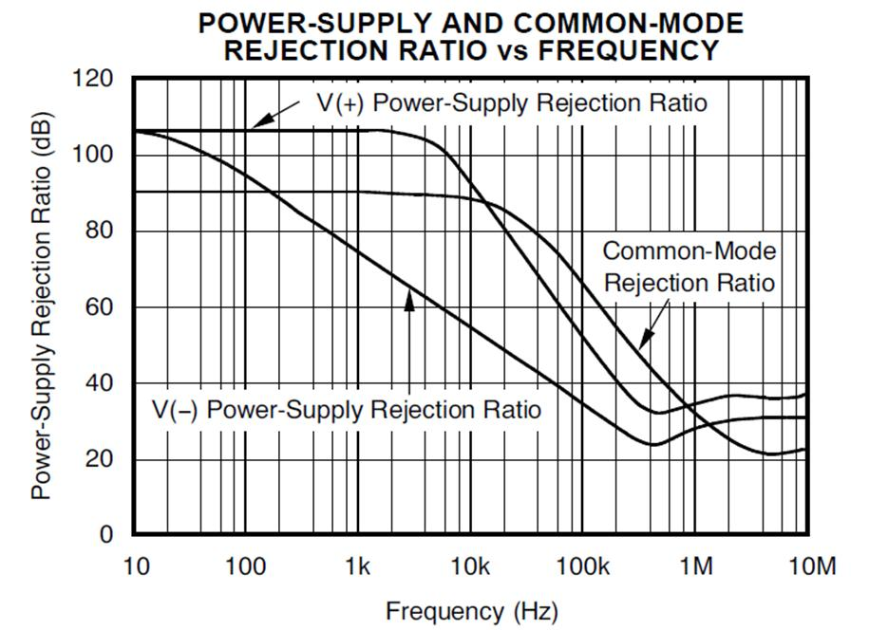
7) Rnp-Cnp Compensation plus Noise Gain Compensation = Improved CMRR
Difference Amp
Noise Gain Compensation
Rnp-Cnp Compensation
CMRR = 69dB @ 600kHz
OPA2367
CMRR = 40dB @ 600kHz
<number>

Slide 134
8) Transient Analysis: Rnp-Cnp Compensation plus Noise Gain Compensation
<number>

Slide 135
8) Transient Analysis: Rnp-Cnp Compensation plus Noise Gain Compensation
<number>

